Slide 1
The South Australia
Presentation is made by
Vira Lytvyn

Slide 2
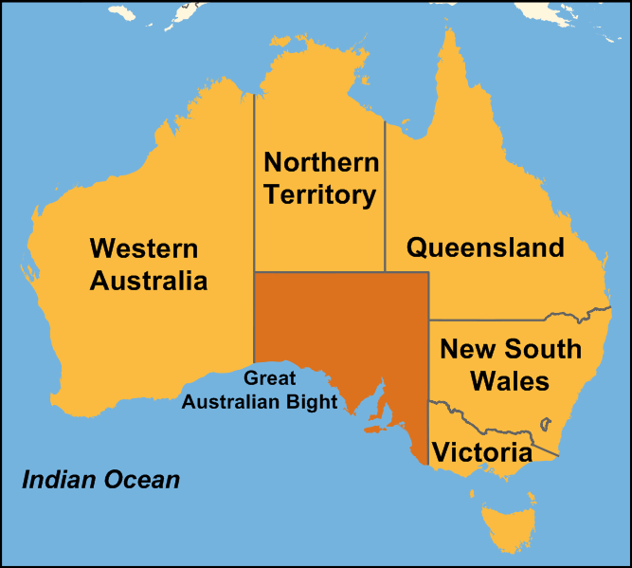
South Australia (SA) is a state of Australia in the southern central part of the country. It covers some of the most arid parts of the continent; it is the fourth largest of Australia's six states and two territories. South Australia is bordered to the west by Western Australia, to the north by the Northern Territory, to the north-east by Queensland, to the east by New South Wales, to the south-east by Victoria, and to the south by the Great Australian Bight and the Indian Ocean.

Slide 3
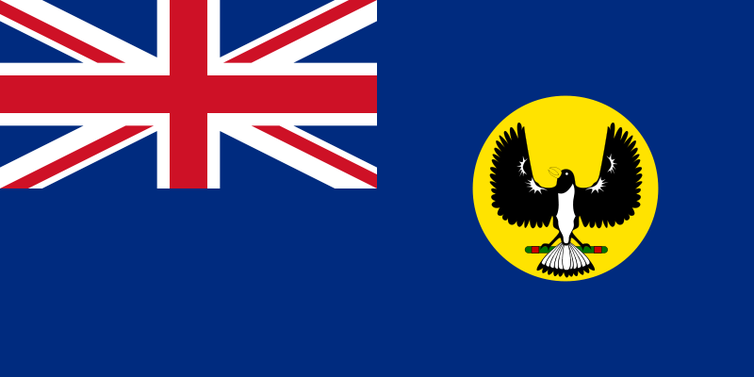
Flag of South Australia

Slide 4
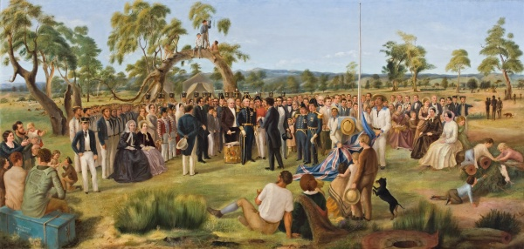
Official settlement began on 28 December 1836, when the colony was proclaimed at The Old Gum Tree by Governor John Hindmarsh.

Slide 5
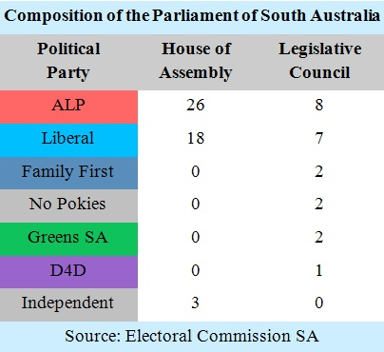
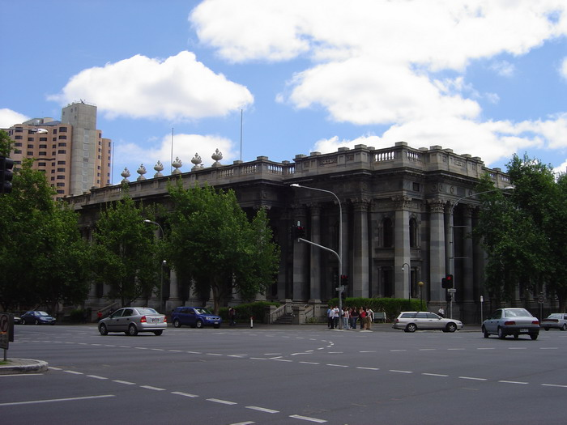
South Australia is a constitutional monarchy with the Queen of Australia as Sovereign, and the Governor of South Australia as her representative. It is a state of the Commonwealth of Australia. Its bicameral parliament consists of a House of Assembly (lower house) and a Legislative Council (upper house), with legislative elections held every four years. The current Premier of South Australia is Jay Weatherill, a member of the Australian Labor Party.
Parliament House, Adelaide

Slide 6
South Australia's economy
South Australia's economy includes the following major industries: meat and meat preparations, wheat, wine, wool and sheepskins, machinery, metal and metal manufactures, fish and crustaceans, road vehicles and parts, and petroleum products. Other industries, such as education and defense technology, are of growing importance. South Australia's economy relies on exports more than any other state in Australia.

Slide 7
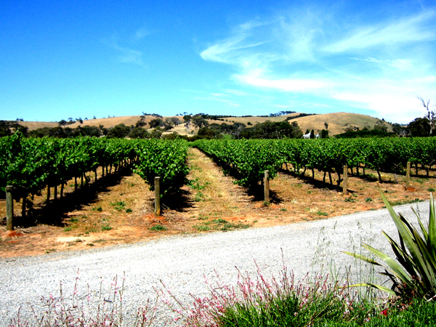
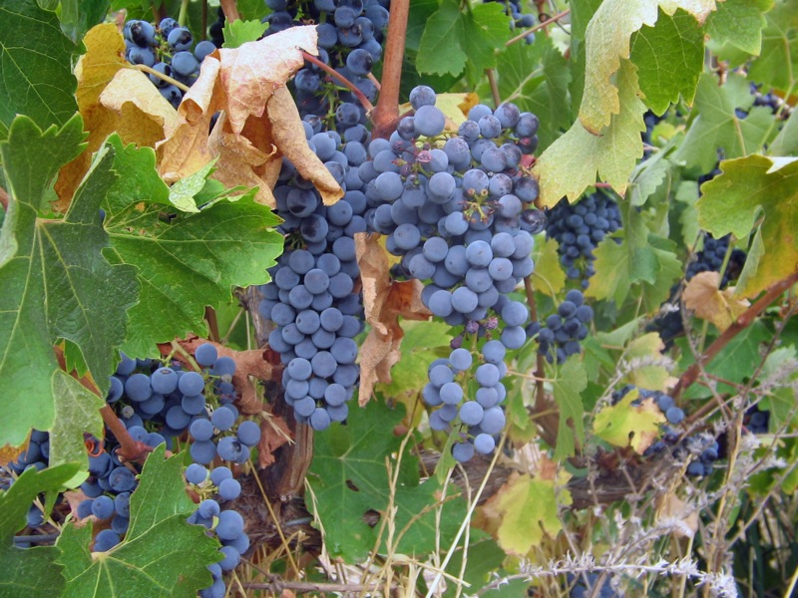
The principal industries and exports of South Australia are wheat, wine and wool. More than half of Australia's wines are produced in the South Australian wine regions which principally include: Barossa Valley, Clare Valley, McLaren Vale, Coonawarra, the Riverland and the Adelaide Hills.
Vineyard in McLaren Vale.
Cabernet Sauvignon from the Clare Valley.

Slide 8
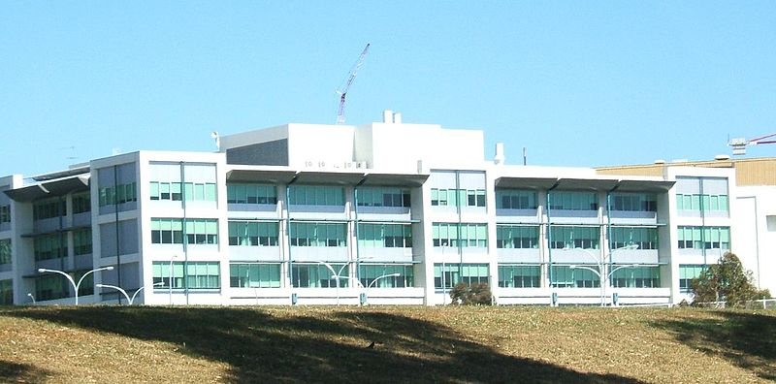
South Australia's largest employment sector is health care and social assistance.
Flinders Medical Centre. Health care and social assistance is the largest ABS defined employment sector in South Australia

Slide 9
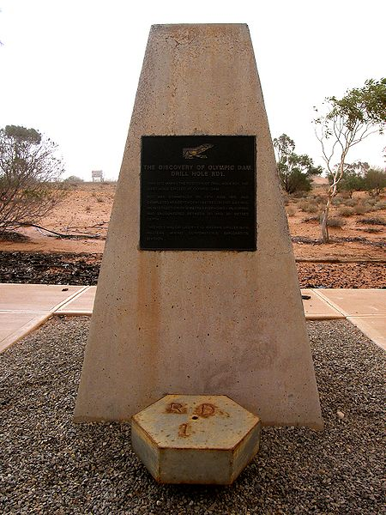
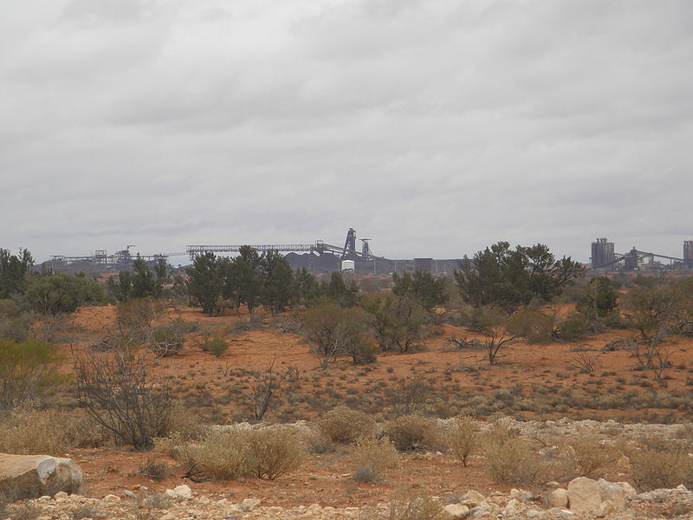
South Australia possesses the world's single largest known deposit of uranium, at the Olympic Dam mine.
Monument at the discovery hole of Olympic Dam, RD1
Main shafts, 2009

Slide 10
Education
Education is compulsory for all children until age 17, unless they are working or undergoing other training. The majority of students stay on to complete their South Australian Certificate of Education (SACE). School education is the responsibility of the South Australian government, but the public and private education systems are funded jointly by it and the Commonwealth Government.
There are three public and three private universities in South Australia.

Slide 11
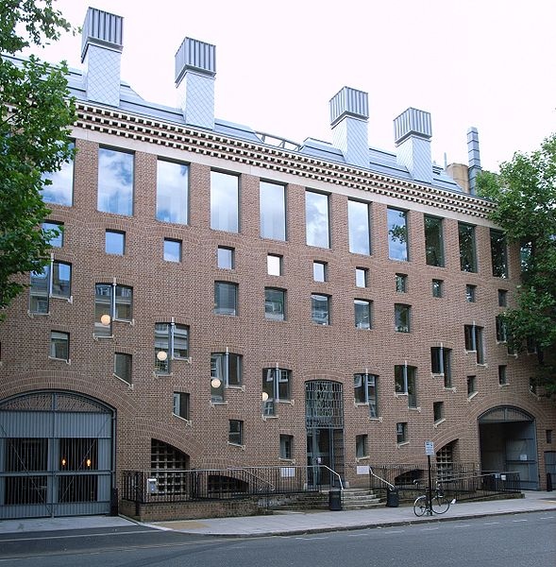
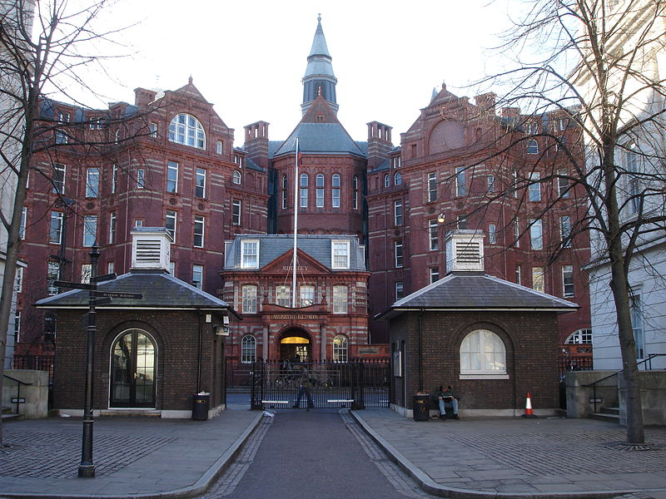
Schools
16 Taviton Street (home to the UCL School of Slavonic and East European Studies)
The Cruciform Building on Gower Street houses the preclinical facilities of the UCL Medical School;

Slide 12
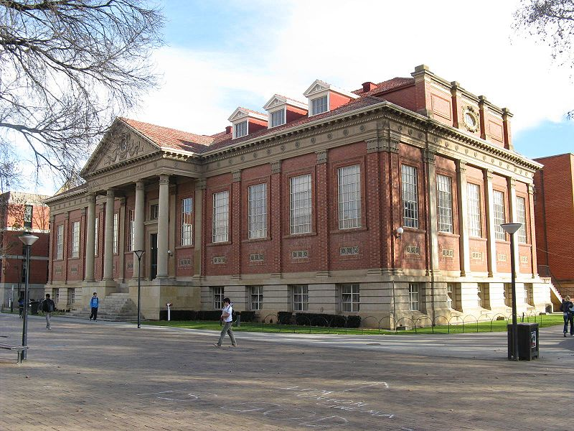
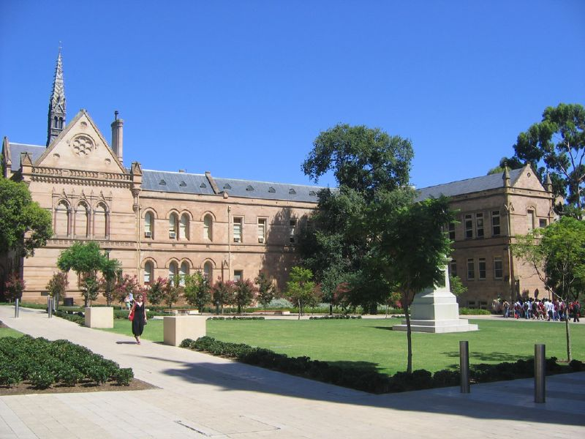
The University of Adelaide (established 1874)
The Barr Smith Library.
View of eastern side of the Mitchell Building from North Terrace, 2007

Slide 13
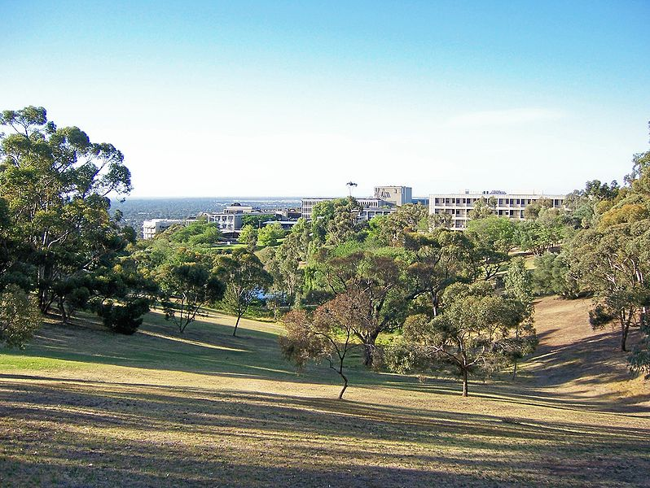
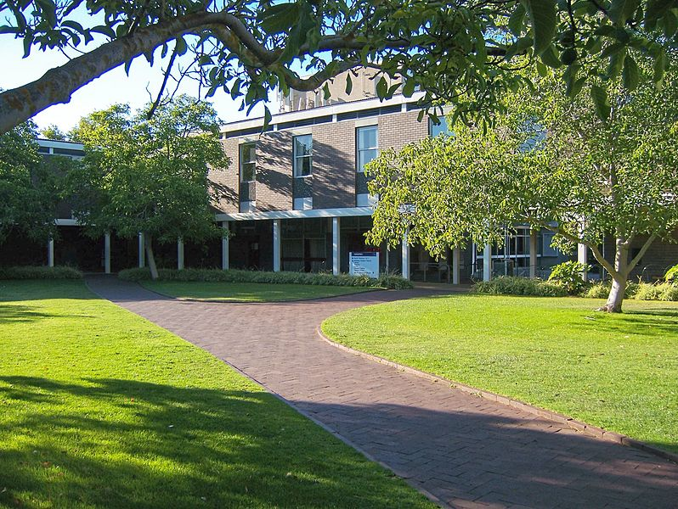
The Flinders University of South Australia
View of Flinders University main campus, with central plaza and lakeside area visible.
View of the courtyard of the Humanities building of the Flinders University.

Slide 14
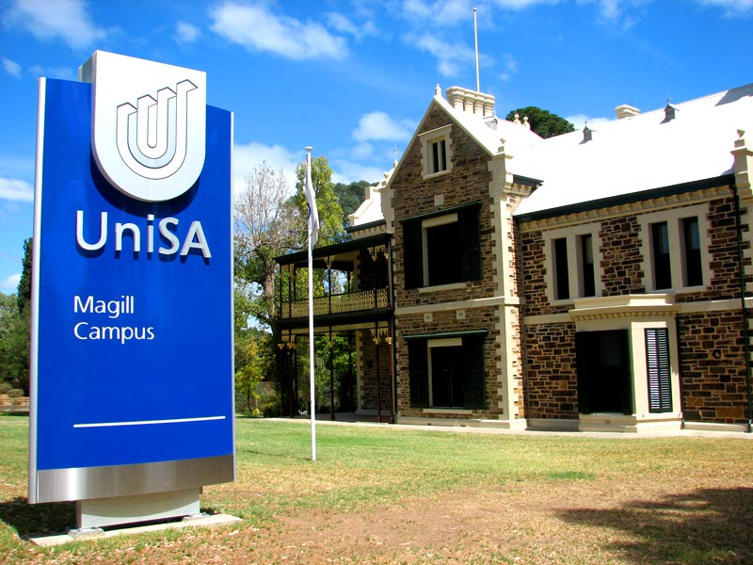
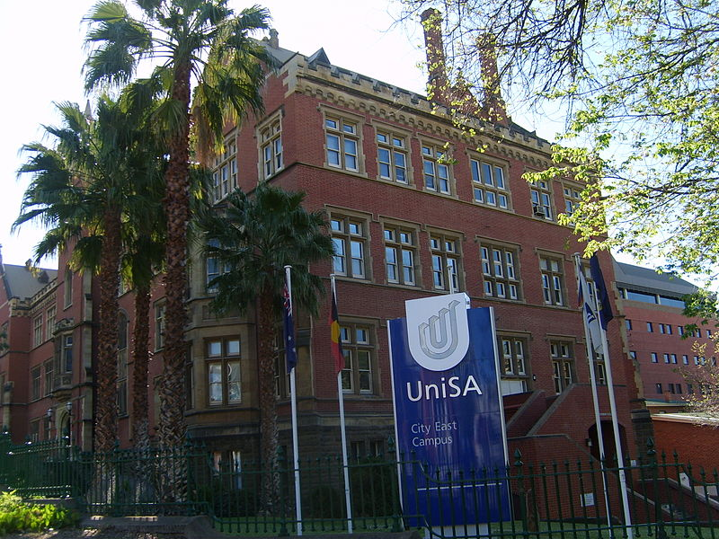
The University of South Australia (UniSA)
UniSA Magill Campus
UniSA City East Campus, Brookman Building

Slide 15
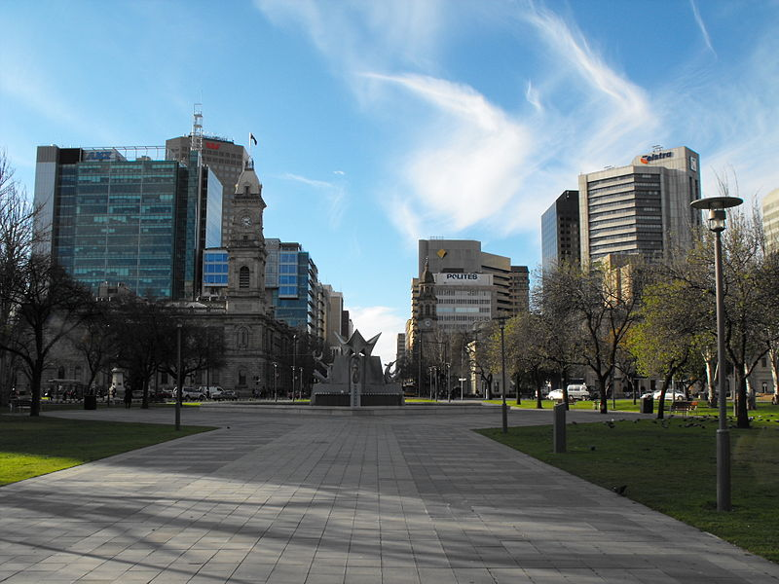
Carnegie Mellon University
Victoria Square, Adelaide
Motto: "My heart is in the work"
(Andrew Carnegie)

Slide 16
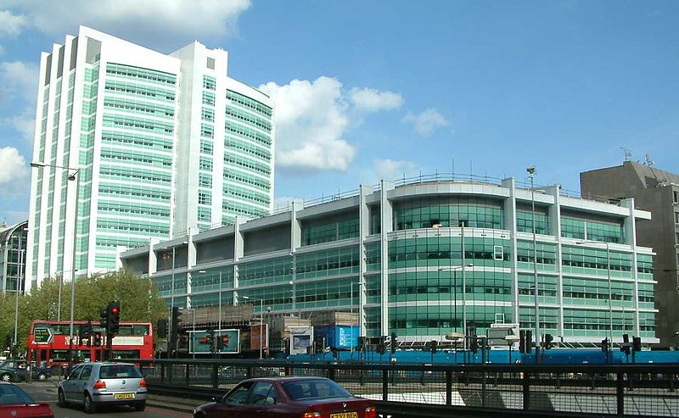
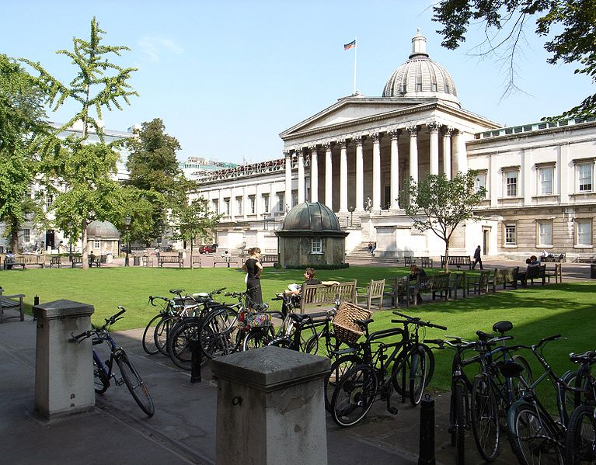
University College London
A summertime view from the South-Western corner of the quadrangle towards the UCL main building on Gower Street
University College Hospital, 235 Euston Road

Slide 17
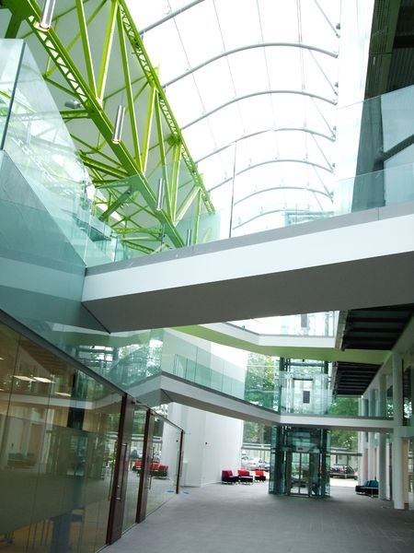
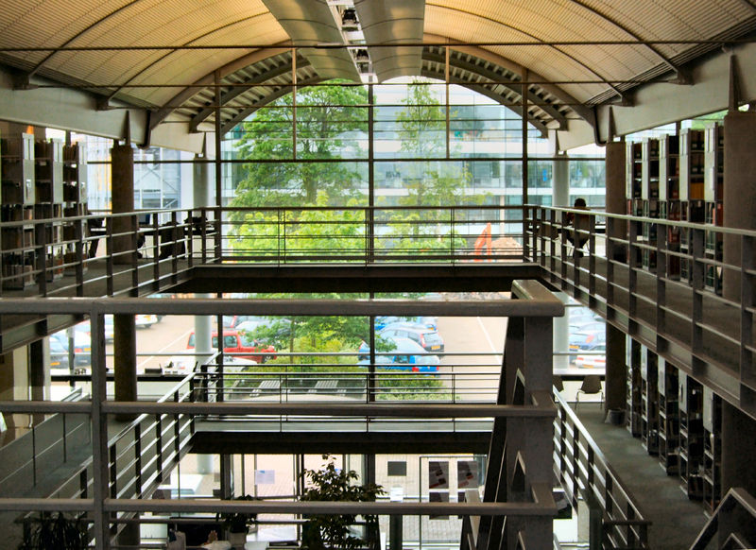
Cranfield University
The new School, 'Cranfield Health' interior
The new School, 'Cranfield Health' prior to official opening, May 2008, viewed from the Library

Slide 18
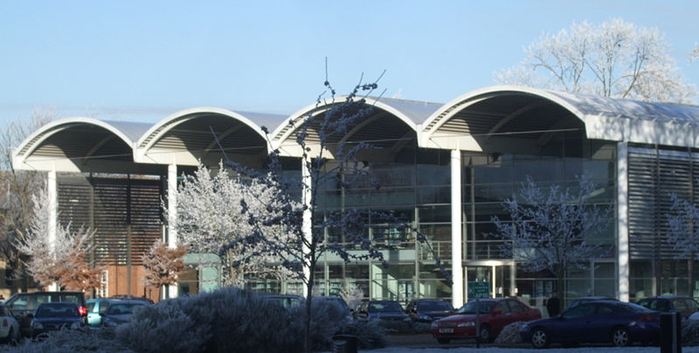
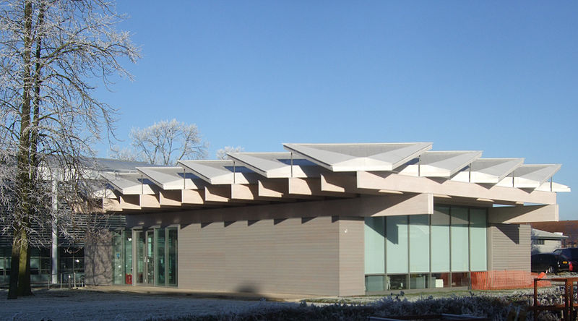
Cranfield University
Cranfield University Library
C4D Building, the Centre for Creative Competitive Design, opened 2010

Slide 19
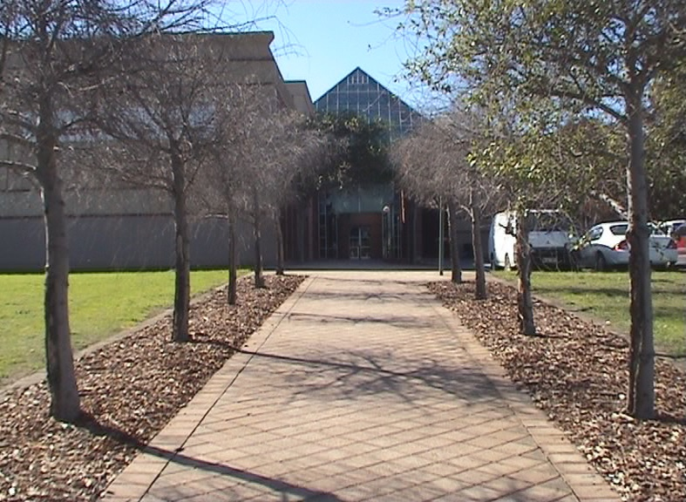
Tea Tree Gully TAFE campus
Tertiary vocational education is provided by TAFE South Australia colleges throughout the state.

Slide 20
Sports
Australian rules football is the most popular spectator sport in South Australia, with South Australians having the highest attendance rate in Australia.
Cricket is the most popular summer sport in South Australia and attracts big crowds.
South Australia's Association Football (soccer) team in the A-League is Adelaide United F.C. The club's home ground is Hindmarsh Stadium.
Fifty-nine percent of South Australian children take part in organised sports. For boys, soccer has the highest participation rate (22%), followed by swimming (16%). For girls netball is most popular (18%), also followed by swimming (16%).

Slide 21
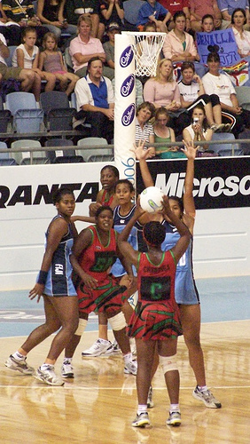
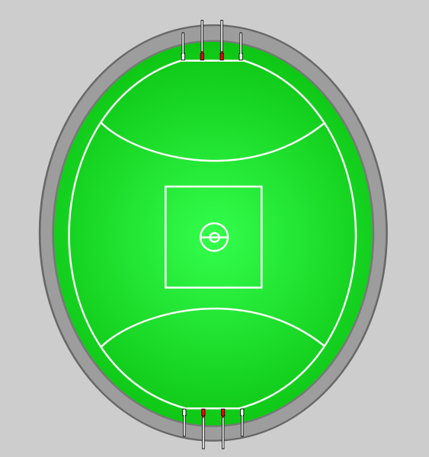

Typical Australian rules football playing field.
Precise field and goal kicking using the oval shaped ball is the most important skill in Australian rules.
West End Redbacks

Slide 22
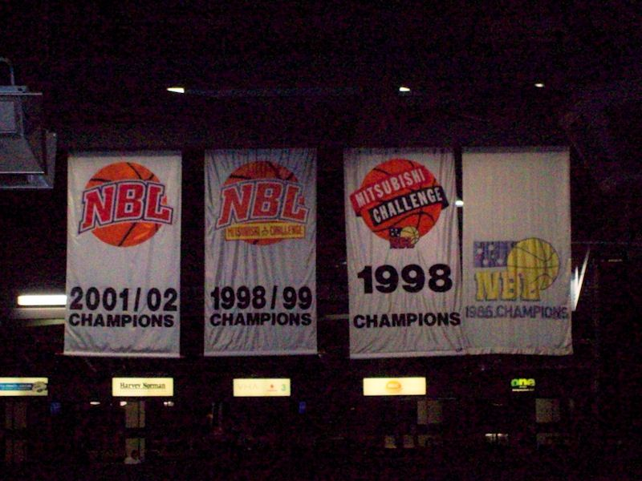
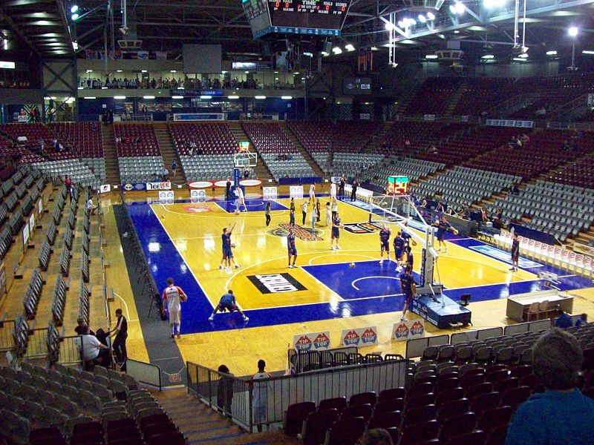
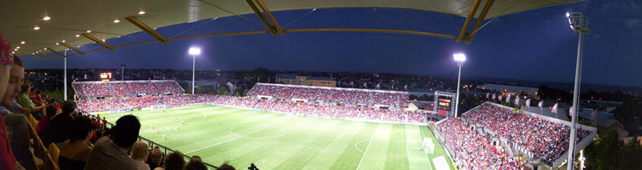
Adelaide 36ers NBL Championship banners
The Brett Maher Court
Panorama View of Hindmarsh Stadium

Slide 23
The most interesting about South Australia

Slide 24
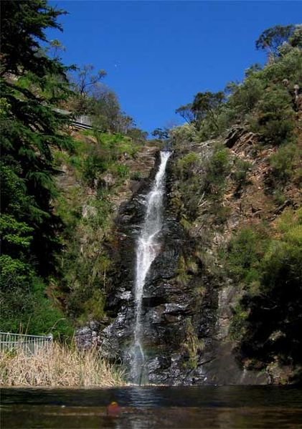
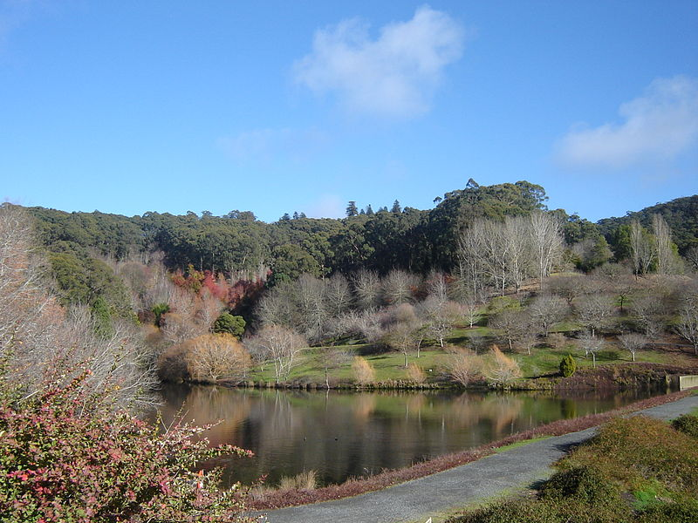
The Waterfall Gully waterfall in the Adelaide Foothills
Looking out over the Mount Lofty Botanic Gardens lower lake

Slide 25
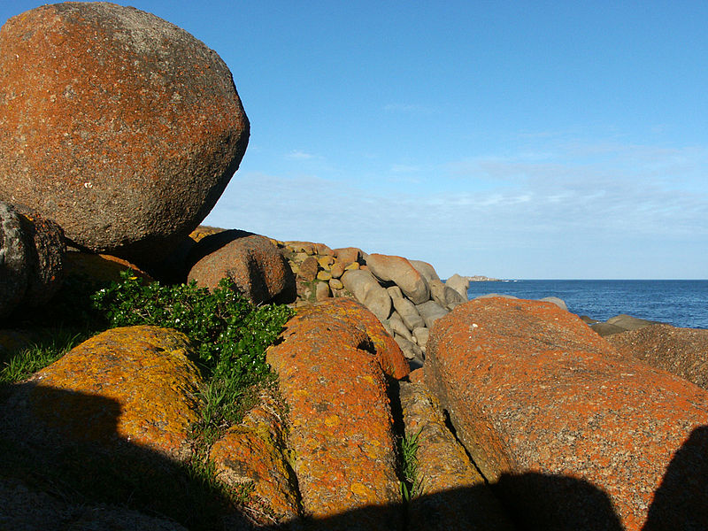
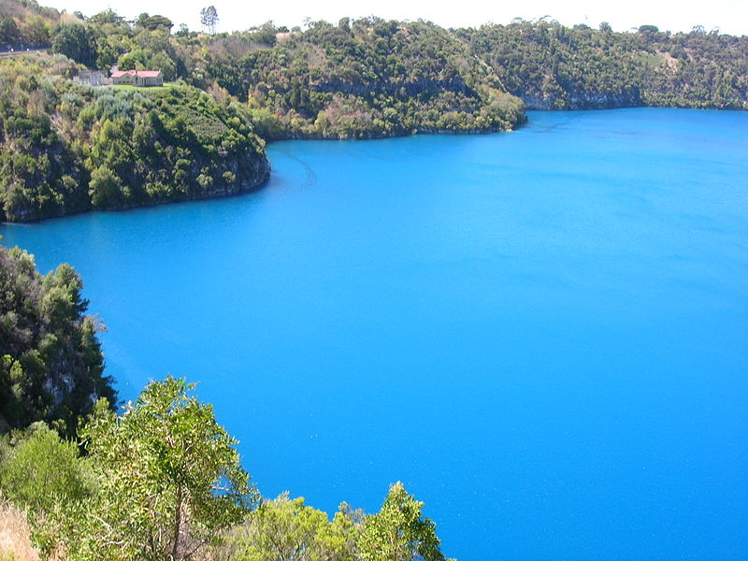
Boulders at sunset on Granite Island
Blue Lake,
Mount Gambier

Slide 26
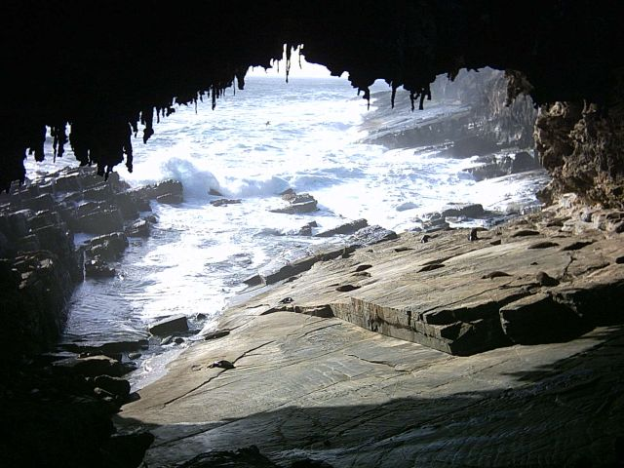
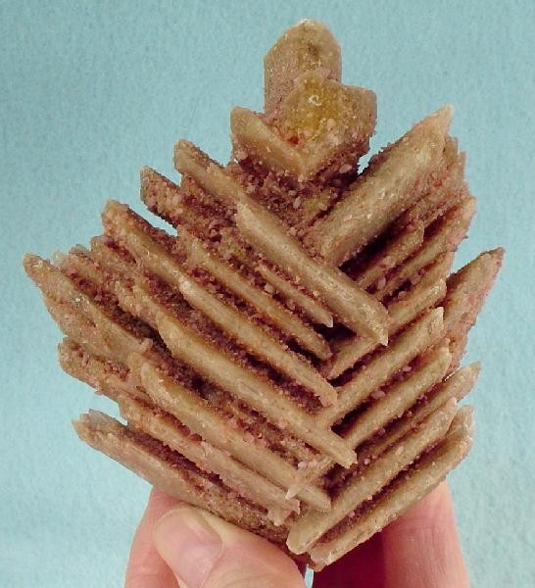
Unusual herringbone crystals of evaporite gypsum, from Sinclairs Gap Lake, Middleback Range, Eyre peninsula.
Admiral's Arch

Slide 27
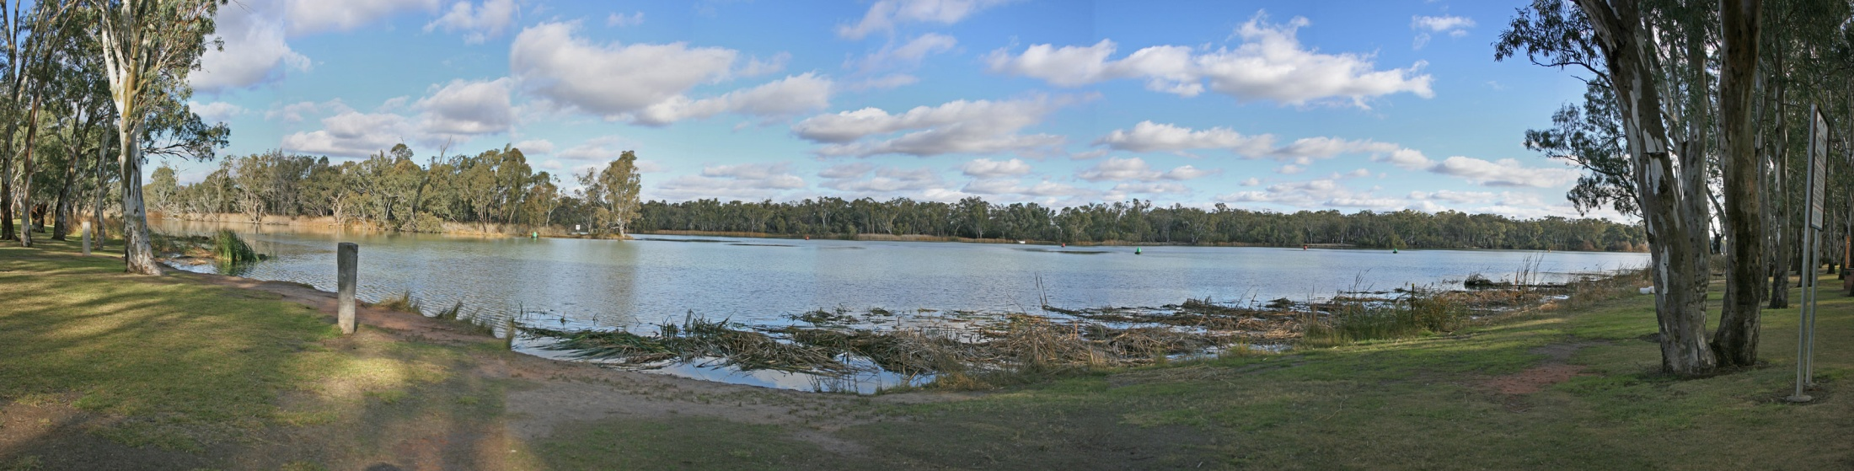
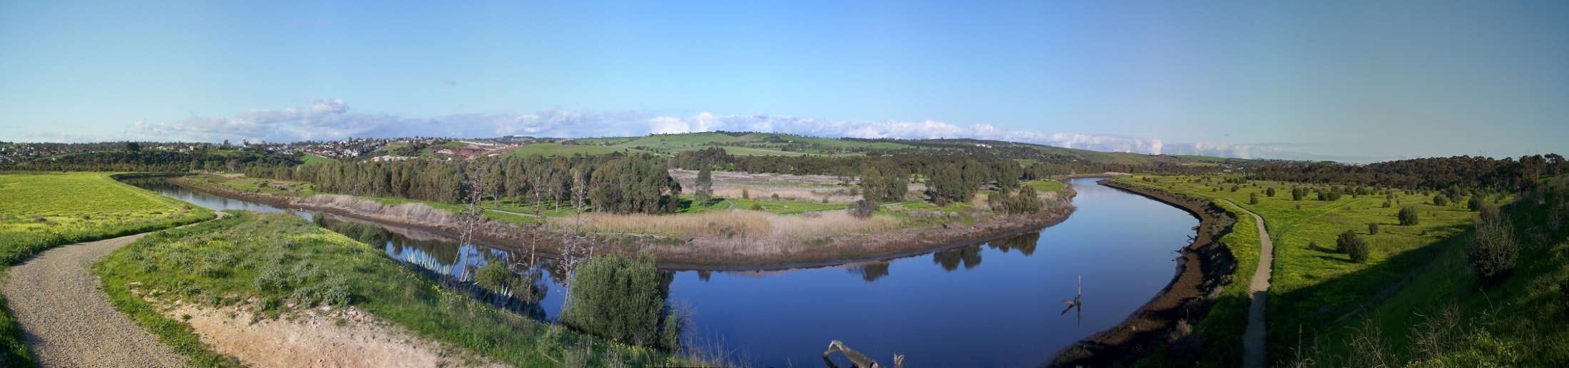
The confluence of the Darling and Murray Rivers at Wentworth, New South Wales
Onkaparinga Estuary in Winter at late afternoon looking East towards Onkaparinga River National Park.

Slide 28
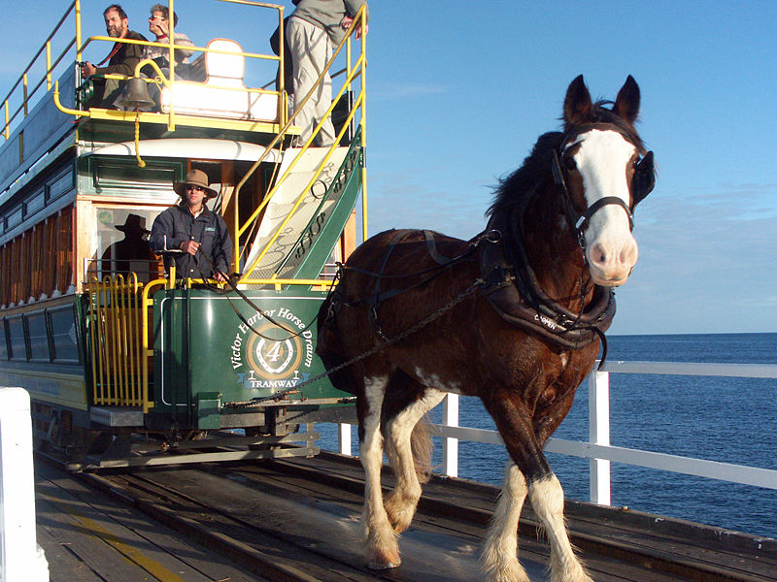
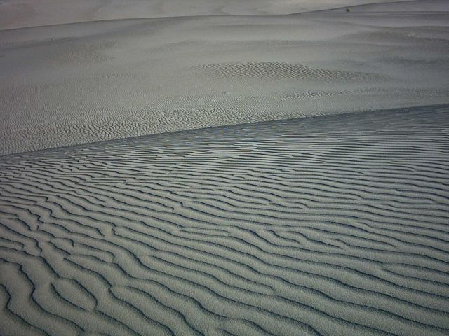
Horse drawn tram on causeway between Granite Island and Victor Harbor
Little Sahara

Slide 29
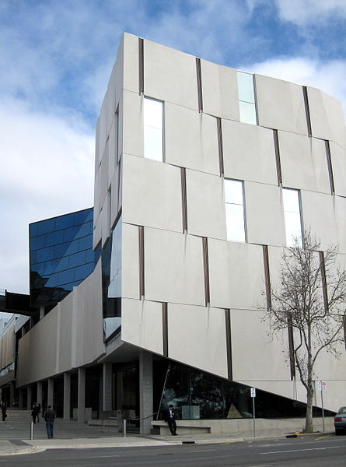
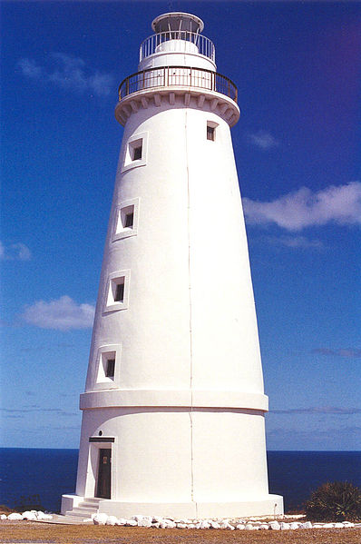
The Hawke Building, part of the UniSA, City West Campus.
Cape Willoughby Lighthouse

Slide 30
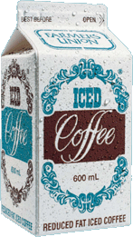
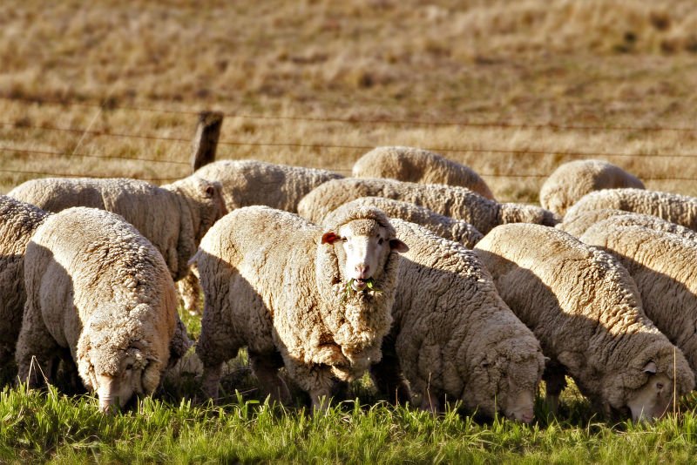
Farmers Union Iced Coffee is a flavored milk drink popular in Australia, primarily the state of South Australia, made by Foods which is now a division of Japanese brewing company Kirin.
Sheep grazing in rural Australia.

Slide 31
Thank you for attention ☺

